Slide 1
Long Text Generation via Adversarial Training with Leaked Information (AAAI 18)
刘辉 信息科学技术学院
林哲 前沿交叉学科研究院
5.14

Slide 2
01
Introduction
02
Methodology
目录
CONTENTS
03
Experiment
04
Contribution

Slide 3
01 Introduction
Recap：自然语言生成模型
语言模型：MLE训练，无隐空间，exposure bias
VAE：编码—高斯分布—解码，难以生成长序列
SeqGAN：Inverse RL，二分类鉴别器，reward信息量小
RankGAN：Ranker鉴别器，reward信息量增大
MaskGAN：完形填空，得到每个词的reward

Slide 4
01 Introduction
Motivation：
之前的方法对长文本生成效果不佳，主要原因有两点：
Reward过于稀疏
标量Reward包含信息太少
LeakGAN：
将鉴别器D的中间结果泄露(Leak)给生成器G
使用Manager—Worker层次式生成器，利用Leakinfo进行生成

Slide 5
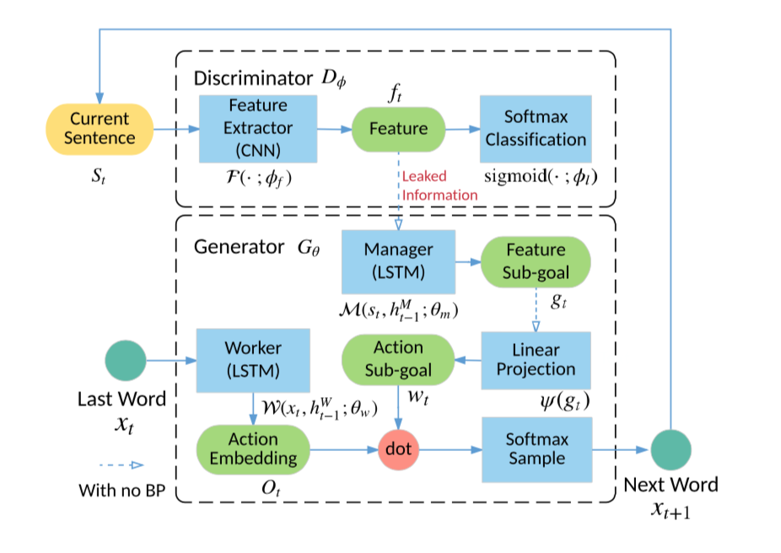
02 Methodology
An overview of LeakGAN

Slide 6
02 Methodology
Leaked Discriminator
鉴别器D（特征提取器 + 分类器）：
从D取得好的reward ⬄ 在特征空间中找到好的子区域
将特征向量f作为指导信号泄露给生成器

Slide 7
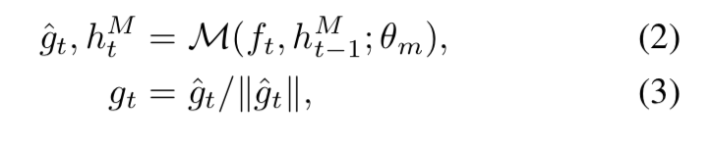
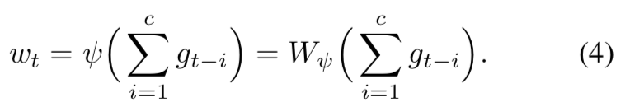
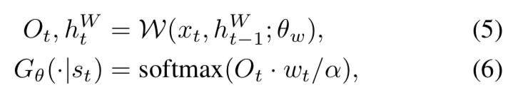
02 Methodology
Hierarchical Generator
生成器G（Manager + Worker）
Manager：
输入特征向量f，输出目标向量g
将最近c个目标向量融合，得到w
Worker：
结合w生成下一个词

Slide 8

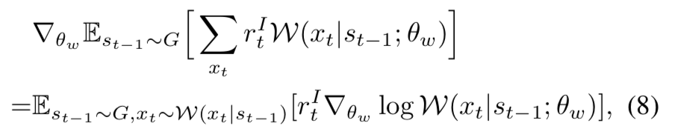
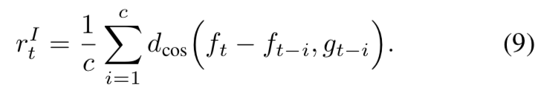
02 Methodology
Training of G
以上计算在G内部可导，可以使用PG同时优化Manager和Worker
为了使Manager捕获一些pattern，分开优化
Manager（预测特征空间中更好的方向）：
Worker（根据Manager提供的方向生成单词，PG）：

Slide 9
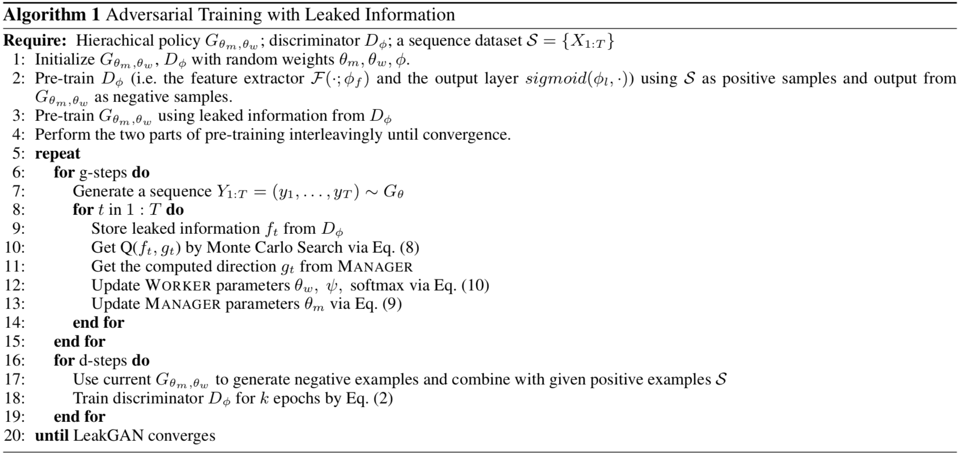
02 Methodology
Adversarial Training procedure

Slide 10
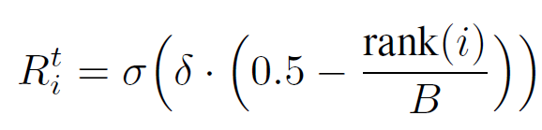
Training Techniques
Bootstrapped Rescaled Activation
severe gradient vanishing occurs when D is much stronger than G,
After this transformation, the expectation and variance of the reward in each mini-batch are constant. In this case, the rescale activation serves as a value stabilizer that is helpful for algorithms that are sensitive in numerical variance.
Second, as all ranking methods do, it prevents the gradient vanishing problem, which accelerates the model convergence.

Slide 11
Training Techniques
Interleaved Training.
As its name is, we adopt an interleaving of supervised training (i.e. MLE) and adversarial training (i.e. GAN) instead of full GAN after the pre-training.
An explanation of why this scheme works is that blending these two trainings would help GAN get rid of some bad local minimums and alleviate mode collapse. Another justification is that the inserted supervised learning performs an implicit regularization on the generative model to prevent it from going too far away from the MLE solution.
Temperature Control.
The Boltzmann temperature is a factor that could be used to balance the exploration and exploitation for reinforcement learning problems. Here we select a higher temperature when we are training the model and a lower temperature when we adopt the model to generate samples.

Slide 12
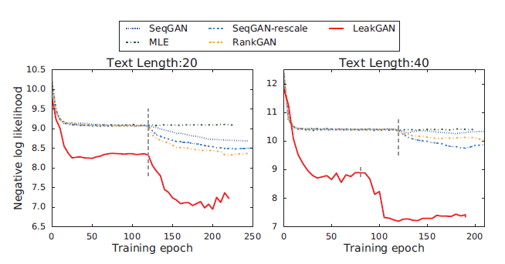
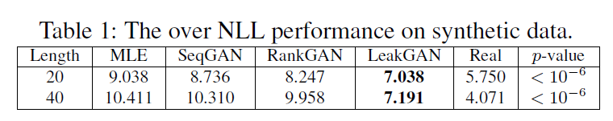
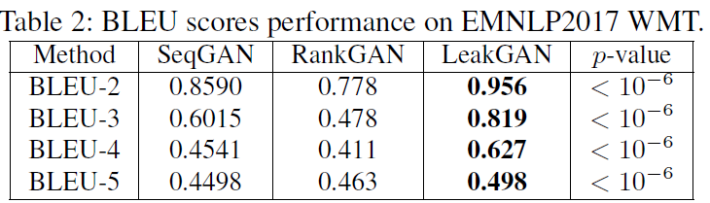
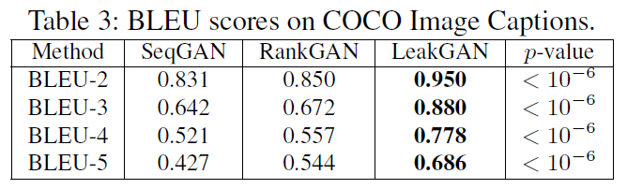
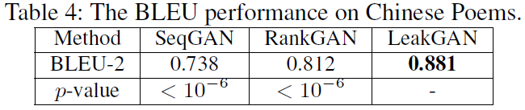
Experiment
Automatic Evalution

Slide 13
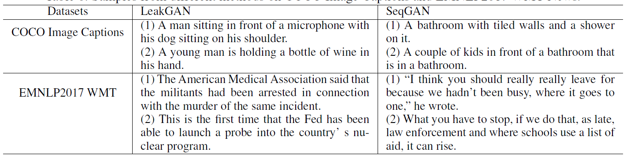
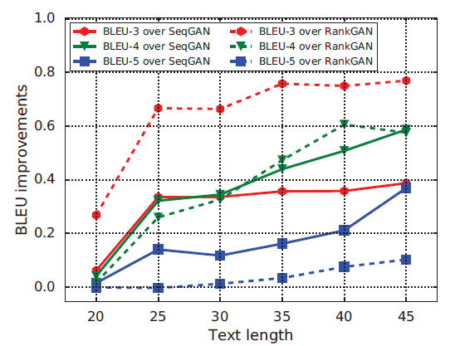
Analysis
Human Judgement

Slide 14
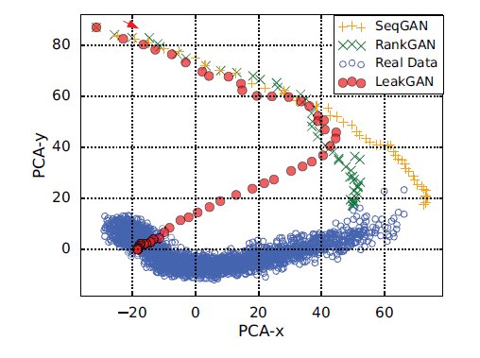
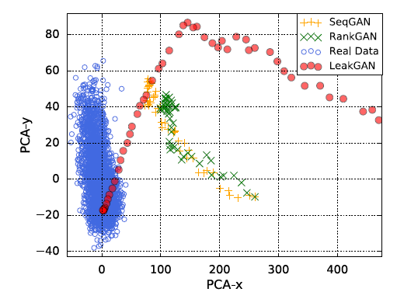
Model Explanation
Feature Trace.
To verify that LeakGAN successfully exploits of the leaked message, we visualize the feature vector f_T extracted from the real data by discriminator. Besides, we visualize the feature trace, i.e. the features ft of prefix st during the generation, for LeakGAN, SeqGAN and RankGAN via a 2-D principal component analysis (PCA).
As we can see, during the generation process, in LeakGAN, the feature vector gradually approaches the real data feature vector region. However, previous models, i.e. SeqGAN and RankGAN, fail to match the features even when the generation is completed. This indicates that the proposed Leak- GAN does finish its design purpose of exploiting the leaked information from D to better match the feature vector distributions of real data.

Slide 15
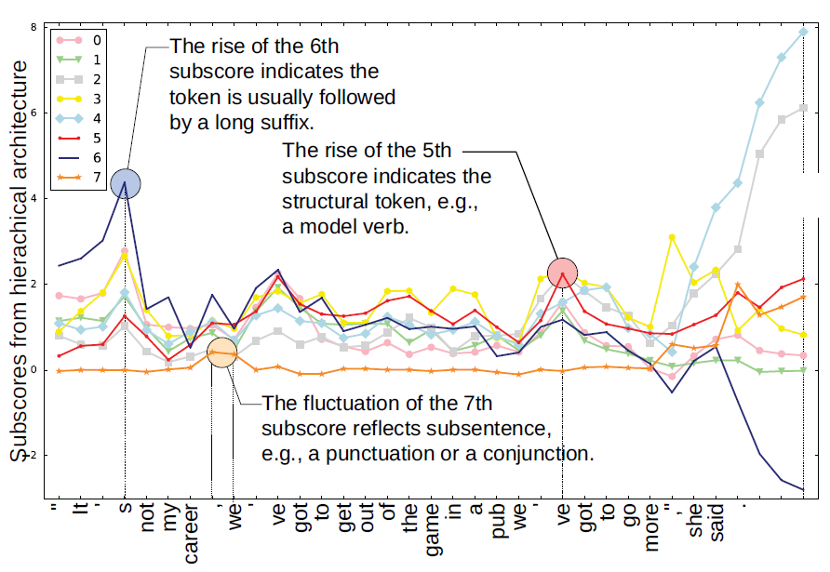
Model Explanation
Behaviors of Worker and Manager.
Visualize the interaction vector of the WORKER and MANAGER, i.e., the dimension-wise product of their output. Note that to simplify the explanation, here we reduce the signal dimension from 16 to 8.

Slide 16
Contribution
1) Introduce a Manage-Worker struct in GAN for sequencec generation.
2) By leaking the feature extracted by the discriminator as the step-by-step guiding signal to guide the generator better generating long text, LeakGAN addresses the non-informativeness and sparsity problems of the scalar reward signal in previous GAN solutions.

Slide 17
THANK YOU
Q & A

